Slide 1
Digital Image Processing
LEC # 3
Notes:
These two things are self explain try

Slide 2

Pixels
The computer stores and displays pixels, or picture elements.
A pixel is the smallest addressable part of the computer screen.
A pixel is stored as a binary code representing a colour.
The code for a pixel can have between
1 and 32 bits of binary code.

Slide 3
Pixel Depth
Pixel Depth describes the number of bits used to store each pixel.
The greater the pixel depth, the more colours a pixel can have.
Colour graphics vary in realism depending on resolution and pixel depth.
The greater the pixel depth, the bigger the file.

Slide 4
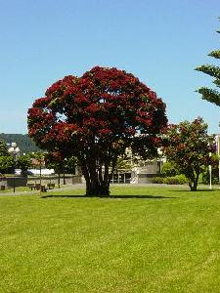

Digital Images
So a digital image contains a 2D array of pixels
Each pixel may either have a single grey value or several (colour) values, typically RGB (red, green, blue)
Red: 33
Green: 11
Blue: 14

Slide 5
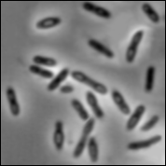
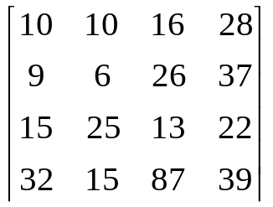
Intensity Image
Intensity or Monochrome Image
each pixel corresponds to light intensity
normally represented in gray scale (gray
level).
Gray scale values

Slide 6
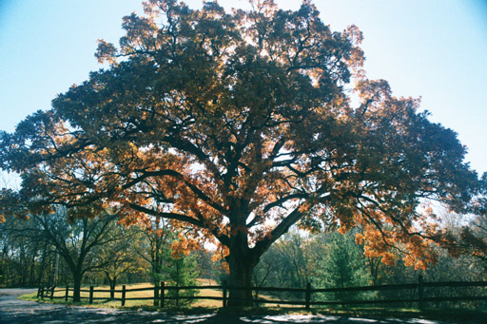
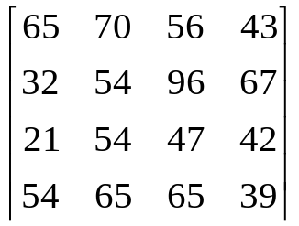
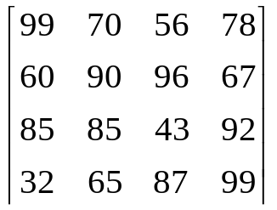
RGB Image
Color or RGB Image:
each pixel contains a vector
representing red, green and
blue components.
RGB components

Slide 7

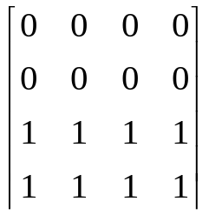
Binary Image
Binary or Black and White Image
Each pixel contains one bit :
1 represent white
0 represents black
Binary data

Slide 8

Examples of Pixel Depth
Monochrome
Monochrome graphics have one-bit pixel depth. (pure black or pure white)

Slide 9

Examples of Pixel Depth
Gray-Scale
Gray-Scale graphics have more bit-depth
(No colours besides black, white and grey)

Slide 10

Examples of Pixel Depth
8 Bit Colour
8 bits per pixel provides 256 colour choices
(Typical of the web - that’s why web graphics need some skilful preparation)

Slide 11

Examples of Pixel Depth
24 or 32 bits per pixel provides thousands or millions of colour choices. (Typical of graphics and games software)

Slide 12

2 x 3 pixels
Notes:
Here’s a photograph that’s only 3 pixels wide and 2 pixels high. You can’t really tell what it’s a picture of and the six individual pixels are about all you can tell about the image.
There’ll be more about this later, but in order to define the color of a pixel it takes 24 bits of data. It doesn’t require much information to save this image less than 1 kilobyte.

Slide 13

25 x 17 pixels
Notes:
Here’s the same photograph, but now with a resolution of 25 x 17 pixels. Now we have enough information to get a vague idea that it’s a picture of something, but not really enough to tell what. The individual pixels still dominate the image.
Even with this much more information, the image still only take 2 kilobytes to remember.

Slide 14

125 x 87 pixels
Notes:
Now the picture is 125 by 87 pixels, a five-fold increase in resolution. We now have enough information to recognize the individuals in the image, although the individual pixels are still apparent.
Because we’re basically dealing with area, that is height times width, file size increases geometrically as resolution increases, and now the image occupies 32 kilobytes of memory, about a much as several pages of text

Slide 15
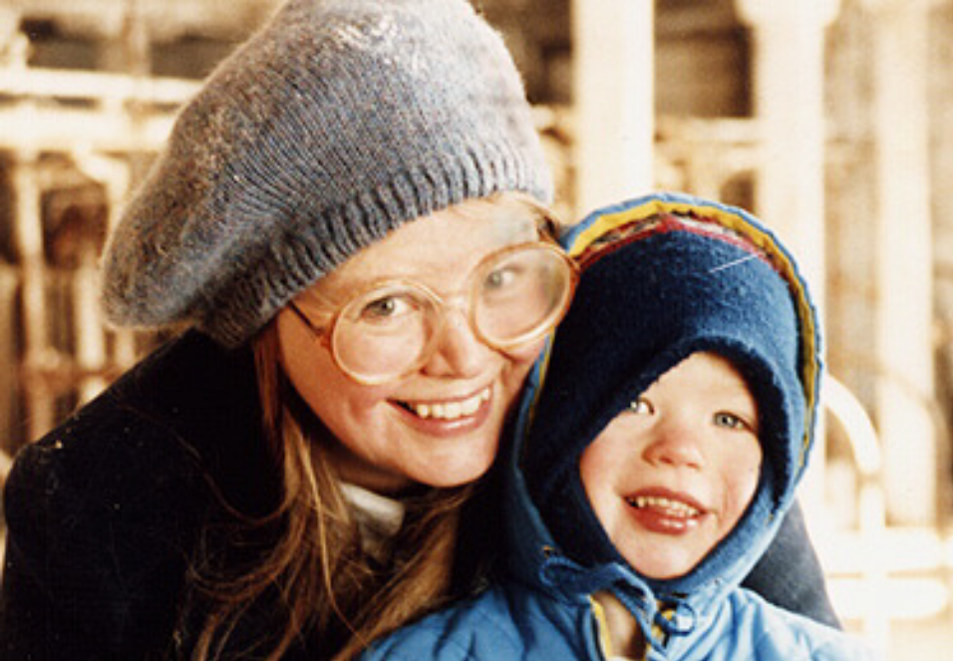
375 x 260
Notes:
I’ve now increased the resolution by 3 times, so the image now is 375 pixels wide by 260 pixels high. It looks pretty good now. In fact we increased the resolution now to the same as the monitor we’re using to look at it, so the individual pixels are no longer apparent.
We have upped the memory requirement to display the image to 286K, and this is only a small picture that fills only a portion of the frame.

Slide 16
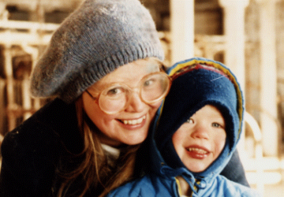
1500 x 1040
4.47MB
Notes:
In this image, the resolution has increased to 1500 x 1040 pixels. On the average monitor, that is about 4 times more pixels than are available for the monitor to display them, so the program has to do a lot of fancy math to recalculate the image to show it at this size. In this case the program is Powerpoint, and it doesn’t do this very well, and the image quality is actually reduced. The amount of data has risen to a staggering 4.47 megabytes, 16 times more than the monitor is capable of using. With most other programs , there won’t be any reduction in quality by using too much data, but it won’t get any better and you can save, transport over your network, and process astounding amounts of data without getting any benefit.

Slide 17
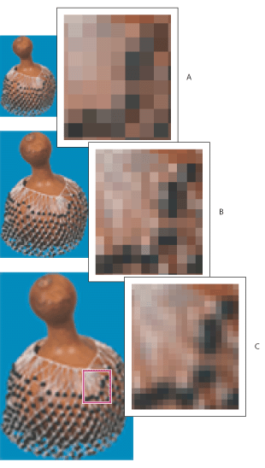
Resolution
Downsampled image
Original image
Resampled-up image

Slide 18
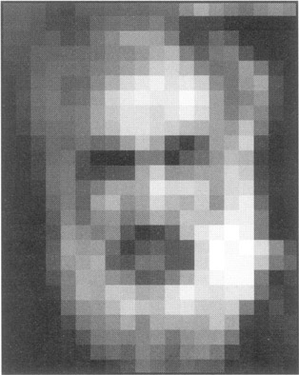
Resolution
Pixellation
  A status when the individual pixels of an image are visible for human eyes due to the low resolution.

Slide 19
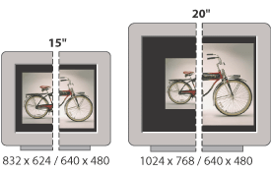
Resolution
Monitor Resolution
    Image data are translated directly into monitor pixels.
    Monitor resolution depends on the size of the monitor(15”, 21”) plus its pixel setting(1024*768, 640*480)

Slide 20
Resolution
Printer Resolution
    The number of ink dots per inch (dpi)
Screen frequency
    Lines of cells per inch in a screen.

Slide 21
Resolution
Resolution (how much you can see the detail of the image) depends on sampling and gray levels.
The bigger the sampling rate (n) and the gray scale (g), the better the approximation of the digitized image from the original.
The more the quantization scale becomes, the bigger the size of the digitized image.

Slide 22
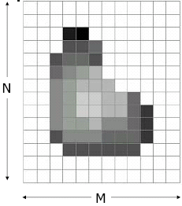
Number of bits
The number of gray levels typically is an integer power of 2
L = 2^{k}
Number of bits required to store a digitized image
b = M x N x k

Slide 23
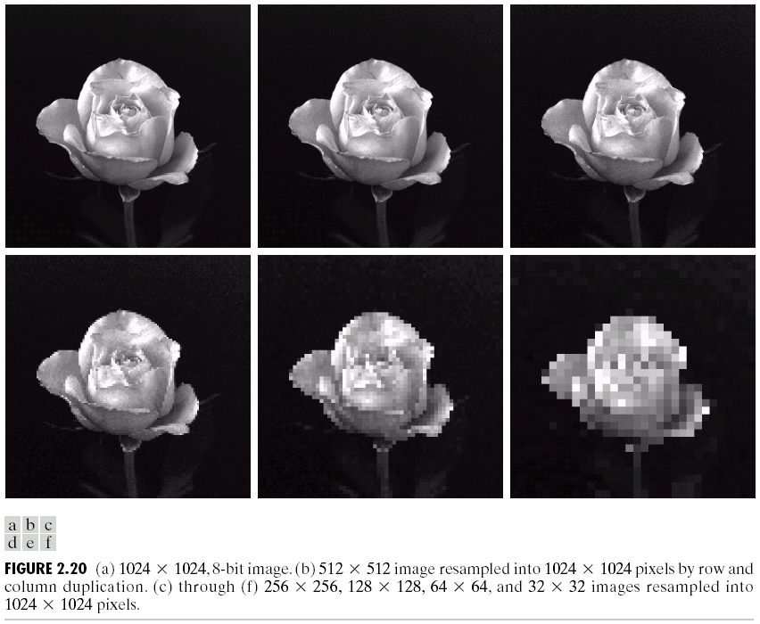
Spatial Resolution
The resolution of an image is described in terms of the number of pixels horizontally (x) and vertically (y) per unit distance

Slide 24
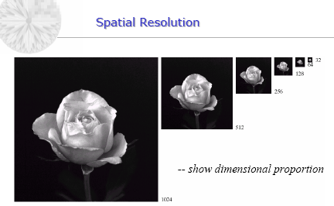
Spatial sub-sampling of 1024 X 1024, 8 bit image.
The gray level quantization is the same for all images.

Slide 25
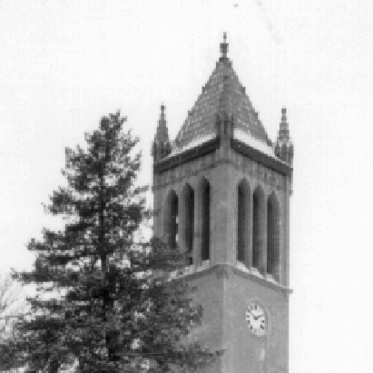


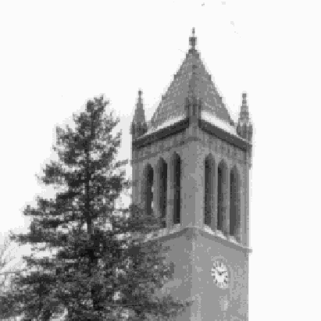




Gray-Level Resolution
Refers to the smallest discernible change in gray level
Specified by the number of gray levels used to represent an image
256 levels
128 levels
16 levels
8 levels
false
contour
64 levels
32 levels
4 levels
2 levels

Slide 26
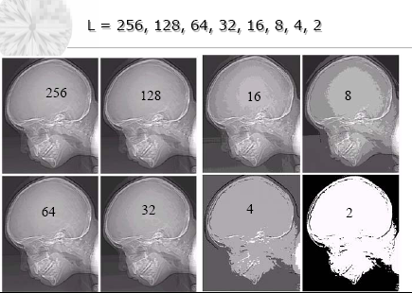

Slide 27
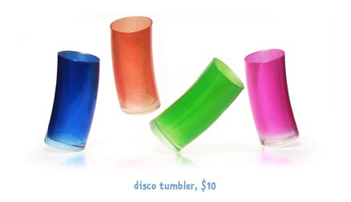



RESOLUTION
72
36
18
9

Slide 28

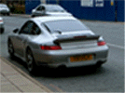
Resolution: How Much Is Enough?
This all depends on what is in the image and what you would like to do with it
Key questions include
  Does the image look aesthetically pleasing?
  Can you see what you need to see within the image?
The picture on the right is fine for counting the number of cars, but not for reading the number plate

Slide 29
How to Choose Spatial Resolution Aliasing
Pixel width = 1/(Spatial resolution)
= Sampling locations
Original image
Sampled image
Under sampling, we lost some image details!

Slide 30
How to Choose Spatial Resolution Nyquist Rate
Sampled image
Original image
2mm
1mm
No detail is lost!
Minimum
Period
Nyquist Rate:
Pixel width must be less or equal
half of the minimum period of the image
or sampling rate must be greater or
equal twice the maximum rate of change (cycles per second)
Pixel width
= Sampling locations

Slide 31
Aliasing Caused by Under-Sampling
Have you ever looked at an electric fan and found it is rotated in a reverse direction?
Sampling rate less than twice the frequency (1/4)
Incorrect result is seen !! - under-sampling problem

Slide 32
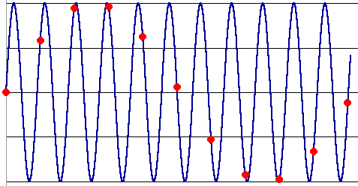
Aliasing (the Moire effect)
The blue curve is the original signal, the red dots indicate the sampled values.
The red dots are what are recorded, since they represent the signal values at the times the signal is sampled. The pattern of the red dots is a terrible representation of the signal. The red sampled data looks like a sine wave at about one-tenth the frequency of the original! This is aliasing.

Slide 33
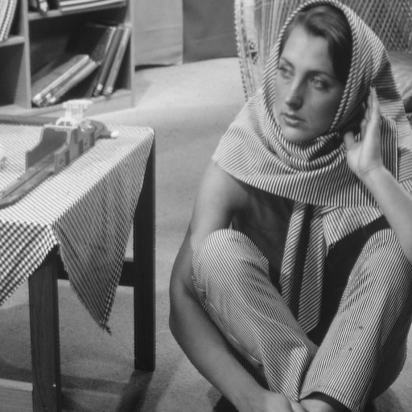



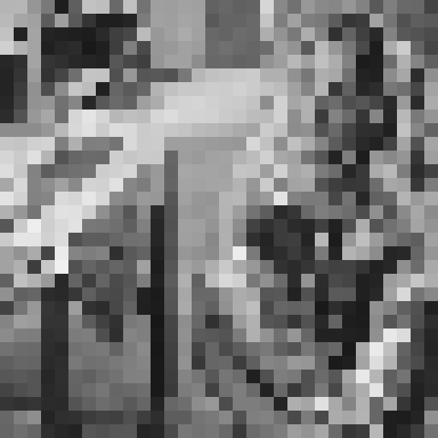
original
Sampled by 2
Sampled by 4
Sampled by 8
Sampled by 16

Slide 34


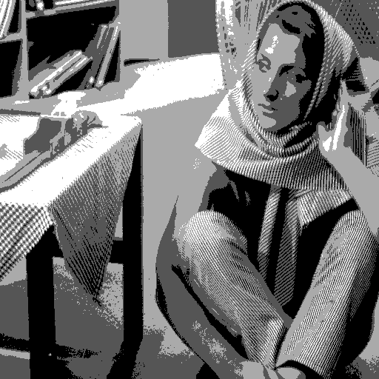
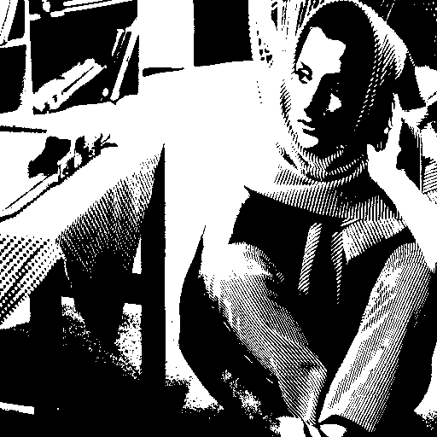
original
128 levels (7 bits)
16 levels (4 bits)
4 levels (2 bits)
2 levels (1 bit)

Slide 35
Neighbors of a pixel
Neighbors of pixel are the pixels that are adjacent pixels of an identified pixel.
Each pixel is a unit distance from the particular pixel.
Some of the neighbors of pixel lie outside the digital image if its position is on the border of the image.

Slide 36

Pixel at coordinate (column x, row y) can be represented by f(x,y)
0 1 2 3 4 5 6 7 8 9 10 11 12 13 14 15
0
1
2
3
4
5
6
7
8
9
10
11
12
13
14
15
Pixel at the
7th column
and 4th row
is yellow color
Zoom1600%

Slide 37
Basic Relationship of Pixels
(0,0)
x
(x-1,y-1)
(x,y-1)
(x+1,y-1)
(x-1,y)
(x,y)
(x+1,y)
y
(x-1,y+1)
(x,y+1)
(x+1,y+1)
Conventional Indexing Method

Slide 38
4-neighbors of pixel
4-neighbors of pixel is denoted by N₄(p)
It is set of horizontal and vertical neighbors
f(x,y) is a yellow circle
(x)
(x+1)
(x-1)
(y-1)
(y)
(y+1)

Slide 39
Neighbours of a Pixel
Neighborhood relation is used to tell adjacent pixels. It is
useful for analyzing regions.
4-neighbors of p:
(x,y-1)
(x−1,y)
(x+1,y)
(x,y−1)
(x,y+1)
(x-1,y)
p
(x+1,y)
N₄(p) =
(x,y+1)
4-neighborhood relation considers only vertical and
horizontal neighbors.
Note: q ∈ N₄(p) implies p ∈ N₄(q)

Slide 40

Adjacency, Connectivity
Given a set of gray values V then for two pixels p, q we define:
  4-adjacency - if val(p), val(q) ∈V and q ∈
4- Connected
V={1}
Not 4-connected
V={1}
1
1
1
1
p
q
p
q

Slide 41
Diagonal neighbors of pixel
Diagonal neighbors of pixel is denoted by N_{D}(p)
It is set of diagonal neighbors
(x-1)
(x)
(x+1)
f(x,y) is a yellow circle
(y-1)
(y)
(y+1)

Slide 42
Neighbours of a Pixel
Diagonal neighbors of p:
(x-1,y-1)
(x+1,y-1)
(x−1,y−1)
(x+1,y−1)
(x−1,y+1)
(x+1,y+1)
p
N_{D}(p) =
(x-1,y+1)
(x+1,y+1)
Diagonal -neighborhood relation considers only diagonal neighbor pixels.

Slide 43
8-neighbors of pixel
8-neighbors of pixel is denoted by N₈(p)
4-neighbors and Diagonal neighbors of pixel
(x-1)
(x)
(x+1)
f(x,y) is a yellow circle
(y-1)
(y)
(y+1)

Slide 44
Neighbours of a Pixel
8-neighbors of p:
(x-1,y-1)
(x,y-1)
(x+1,y-1)
(x−1,y−1)
(x,y−1)
(x+1,y−1)
(x−1,y)
(x+1,y)
(x−1,y+1)
(x,y+1)
(x+1,y+1)
(x-1,y)
p
(x+1,y)
(x-1,y+1)
(x,y+1)
(x+1,y+1)
N₈(p) =
8-neighborhood relation considers all neighbor pixels.

Slide 45
8-Adjacency
8-adjacency - if val(p), val(q) ∈V
q
1
8- Connected
V={1}
1
1
p
q

Slide 46
Connectivity
Connectivity is adapted from neighborhood relation.
Two pixels are connected if they are in the same class (i.e. the
same color or the same range of intensity) and they are
neighbors of one another.
For p and q from the same class
⬥ 4-connectivity: p and q are 4-connected if q ∈ N₄(p)
⬥ 8-connectivity: p and q are 8-connected if q ∈ N₈(p)
⬥ mixed-connectivity (m-connectivity):
p and q are m-connected if q ∈ N₄(p) or
q ∈ N_{D}(p) and N₄(p) ∩ N₄(q) = ∅

Slide 47
Example 4-Connectivity
Set of color consists of color 1 ; C ={1}
0
1
1
0
1
1
0
1
0
0
1
1

Slide 48
Example 8-Connectivity
Set of color consists of color 1 ; C ={1}
0
1
1
0
1
1
0
1
0
0
1
1

Slide 49
Example M-Connectivity
Set of color consists of color 1 ; C ={1}
0
1
1
0
1
1
0
1
0
0
1
1

Slide 50
Implementation of Connectivity
Establishing boundaries of objects and components of regions in an image.
Group the same region by assumption that the pixels being the same color or equal intensity will are the same region

Slide 51
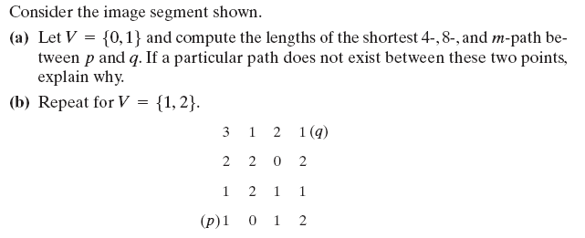
Do yourself

